Slide 1

Lakshmi Narain College Of Technology & Science, Bhopal(M.P.)
Topic :- Design And Fabrication Of Multipurpose Agricultural Machine
Submitted By: Submitted to:
Shahbaz Hussain Ansari (0157ME161124) Dr. Naveen Agrawal (H.O.D)
Sushant Raj (0157ME161137) Mechhanical Department,
Shubham Patel (0157ME161128) LNCT&S, Bhopal(M.P.)
Sachin Patel (0157ME161114)
Guide By :
Prof. Mukesh Ahirwar

Slide 2
Design and fabrication of multipurpose agriculture machine

Slide 3
Introduction
The robotic systems play an immense role in all sections of societies, organization and industrial units. The objective of the project is to develop a microcontroller based system at helps in on-farm operations like seeding and fertilizing at pre-designated distance and depths with all applicable.

Slide 4
Robotic Weeding
Robotic weeding Knowing the position and severity of the weeds there are many methods that can kill, remove or retard these unwanted plants Different physical methods can be used that rely on physical interaction with the weeds. A classic example is to break the soil and root interface by tillage and promote wilting of the weed plants. This can be achieved in the inter row area easily by using classical spring or duck foot tines. Intra row weeding is more difficult as it requires the position of the crop plant to be known so that the end effector can be steered away.

Slide 5
Micro Spraying
Micro spraying within the close-to-crop area, great care must be taken not to damage the crop nor disturb the soil. One method of killing weeds close to the crop plants is to use a micro spray that delivers very small amounts directly on to the weed leaf. Machine vision can be used to identify the position of an individual weed plant and a set of nozzles mounted close together can squirt a herbicide on to the weed.

Slide 6
Advantage
• Reduce the manual work
• Less skill technicians is sufficient to operate.
• Installation is simplified very much
• Labor requirement reduces
• Quantity of seeds reduces

Slide 7
Disadvantage
Electronics component cannot sustain the vibrations and the high temperature.
Accuracy should be reduces due to clod and mud.

Slide 8
LITERATURE REVIEW
Kyada A et al. This research paper presents design and development of manually operated seed planter machine. In this they present objective of seed planter machine design, factors affecting seed emergence, some mechanisms. The basic objective of sowing operation is to put the seed and fertilizer in rows at desired depth and seed to seed spacing, cover the seeds with soil and provide proper compaction over the seed. The recommended seed to seed spacing and depth of seed placement vary from crop to crop and for different agro-climate conditions to achieve optimum yields.

Slide 9
LITERATURE REVIEW
Ramesh D et al. This research paper present “Agriculture Seed Sowing Equipment: A Review”. The present review provides brief information about the various types of innovations done in seed sowing equipment. The basic objective of sowing operation is to put the seed and fertilizer in rows at desired depth and seed to seed spacing, cover the seeds with soil and provide proper compaction over the seed. In this multipurpose seeding machine equipment consists of cylindrical shape container in which the seeds can fill. The container is attached on the four wheeled carrier assembly. It consists of metering plate bevel gear mechanism and two holes at the bottom depending on seed size.

Slide 10
LITERATURE REVIEW
Kannan A et al. This research paper presents design modification in multipurpose sowing machine. In this they present that for sowing purpose we import the machinery which are bulk in size having more cost. To prevent this they design multipurpose sowing machine which consists of hopper, seed metering mechanism, ground wheel, power transmission system, seed distributor, and tiller. In this they design model on PRO-E software. Actually the working is very simple as the tiller rotates it directly transmit motion to ground wheel which directly connected through main shaft. A main shaft has a disc with scoops inside the hopper.

Slide 11
LITERATURE REVIEW
D. Ramesh and H.P.Girishkumar [12]: The paper contrasts the Brazilian and SSA situations and draws lessons and guidelines for the development of the CA equipment industry in SSA. The conclusions indicate that, although the industry in SSA is still in its infancy, there is good potential for support from international donors. Local adaptations are needed for local markets, materials and skills and national governments can play a key role in supporting and promoting CA. Now is precisely the moment for decisive action.

Slide 12
Methodology
Propose system is based on Mechatronics. It is automated multipurpose robot. Features of this robot are seed sowing, insecticide sprinkler and humidity detector. The control section as well as robotic station possess the amenities viz, temperature sensor, humidity sensor, ph sensor, soil moisture sensor, seed dispenser, seed storage, fertilizer storage, fertilizer dispense, robotics system with motors, microcontroller and power supply. It consume less time and other as well as light weighted. It is more efficient than other system.

Slide 13
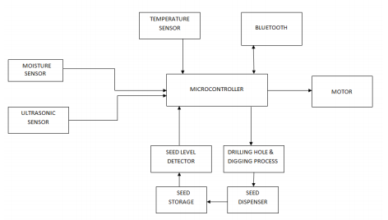
block diagram of robot

Slide 14
Components Used
Microcontroller:
The microcontroller that has been used for this project is from PIC series. PIC microcontroller is the first RISC based microcontroller fabricated in CMOS (complementary metal oxide semiconductor) that uses separate bus for instruction and data allowing simultaneous access of program and data memory. The main advantage of CMOS and RISC combination is low power consumption resulting in a very small chip size with a small pin count.

Slide 15
DC motor
The operation of DC motors consists of conversion of electrical energy into mechanical energy. Basic parts of DC motor are axle rotor, stator, commentator, field magnets and brushes. The DC motors are used to drive the wheels connected to the robot base.

Slide 16
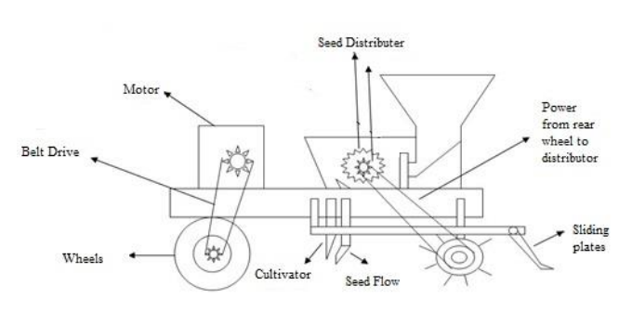
Schematic diagram of a seed sowing robot

Slide 17
Reference
[1] A. R. Kyada & D. B Patel,DEC 2014 “Design And Development Of Manually Operated Seed Planter Machine” of Lecture 5th International & 26th All India Manufacturing Technology, Design and Research Conference (AIMTDR 2014) , IIT Guwahati, Assam, India. Vol 2.
[2] D. Ramesh , H.P. Girishkumar,JULY 2014“ Agriculture Seed Sowing Equipments: A Review” , ISSN N0.:2278-7798,Volume3.
[3] A.Kannan , K. Esakkiraja , S. Thimmarayan, JAN 5014 “Design And Modification Of Multipurpose Sowing Machine” VOL:2 ,ISSN (ONLINE): 2321-3051.
[4] Roshan V. Marode, P.Gajanan, and K.Swapnil ,OCT 2013 “Design & Implementation of Multiseed Sowing Machine”, Vol : 2,No. 4, ISSN No.: 2278-0149, patented.

Slide 18
Reference
A. Rohokale , 2004 “International journal of advanced agriculture system with proper seed spacing”.
B.Shivprasad, M. Ravishankara, B.Shoba.,2010 “Design And Implementation Of Seeding And Fertilizing Agriculture Robot” , Volume 1(3)190-213.
Adityakawadaskar, dr. S. S. Chaudhari “Review of methods of seed sowing and concept of multi-purposeseed sowing machine” “international journal of pure and applied research in engineering and technology” IJPRET, 2013; Volume 1(8): 267-276
S.Chandika ME AMIE, T.Mohanraj “Automation and Emerging Technology Development of 2d seed sowing robo” Journal of agricultural science, Volume 1, June 2009.

